Slide 1
Multithreading in Java

Slide 2
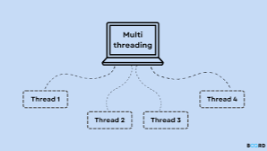
Definition . . .
Multithreading is a programming technique where multiple threads (smaller units of a process) are executed concurrently within a single process. Each thread runs independently but shares the same memory space of the parent process, allowing for efficient communication and resource sharing.

Slide 3
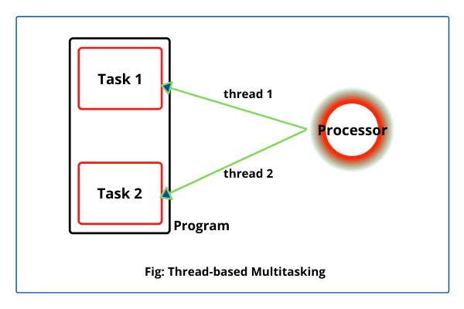
Thread?
Thread: A lightweight sub-process, the smallest unit of execution.

Slide 4
Advantages of Java Multithreading
Improved Performance
Threads can run concurrently, making better use of CPU resources, especially on multi-core systems.
Tasks like I/O operations can be done in parallel with computation-heavy tasks.
Enhanced Responsiveness
In user interfaces (like desktop or mobile apps), multithreading keeps the UI responsive while background tasks (like file loading or network requests) run.

Slide 5
Continue . . .
Efficient Resource Sharing
Threads share the same memory space, which makes communication between them faster and more efficient than between separate processes.
Better System Utilization
Multithreading helps in utilizing the full potential of modern processors by running multiple tasks in parallel.

Slide 6
Continue . . .
Scalability
Applications can scale better with more processors/cores by assigning different threads to different cores.
Cost-Effective Context Switching
Switching between threads is generally faster and uses fewer resources compared to switching between full processes.

Slide 7
Java Thread class
Java provides the Thread class to achieve thread programming. The Thread class provides constructors and methods to create and perform operations on a thread. The Thread class extends the Object class and implements the Runnable interface.

Slide 8
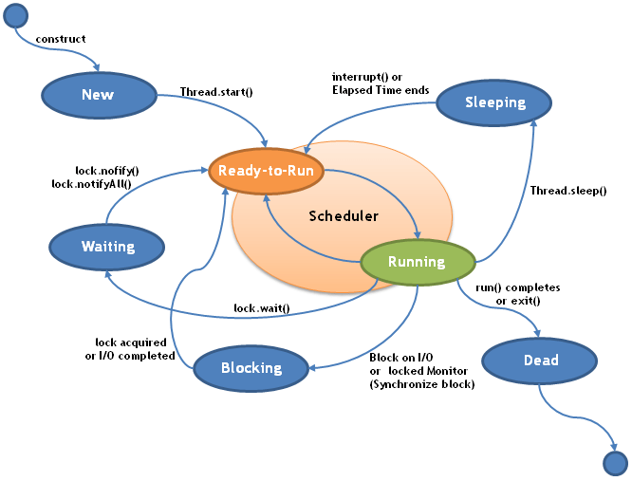
Thread Life Cycle in Java
In Java, a thread always exists in any one of the following states.
New
Active
Blocked / Waiting
Timed Waiting
Terminated

Slide 9
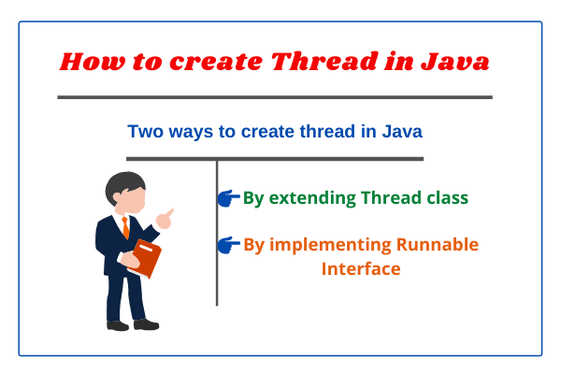
How to Create a Thread in Java?

Slide 10
Thread Creation
Creating Thread by Extending Thread Class
class Multi extends Thread{
public void run()
{
System.out.println("thread is running...");
}
public static void main(String args[])
{
Multi t1=new Multi();
t1.start();
}
}

Slide 11
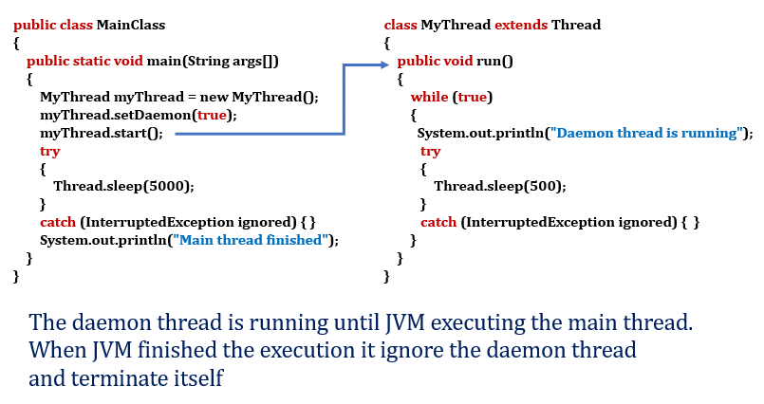

Slide 12
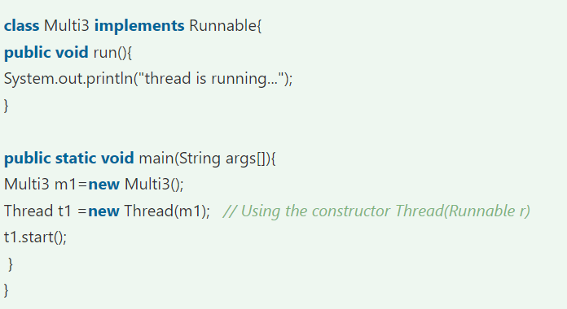
Thread Creation
Java Thread Example by implementing Runnable interface

Slide 13
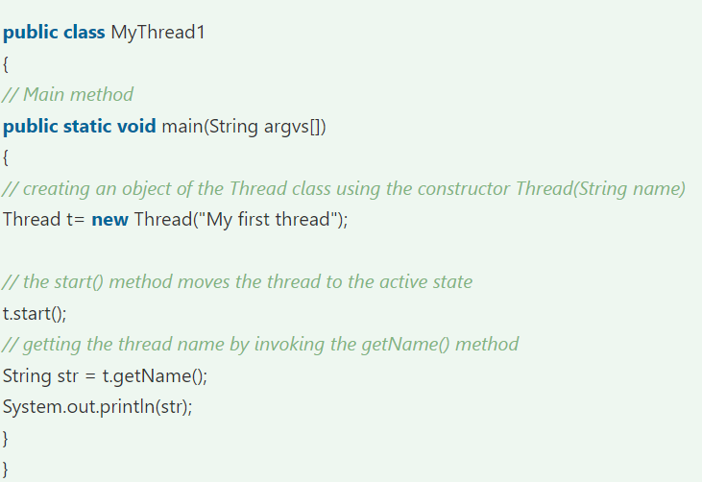
Using the Thread Class: Thread(String Name)

Slide 14
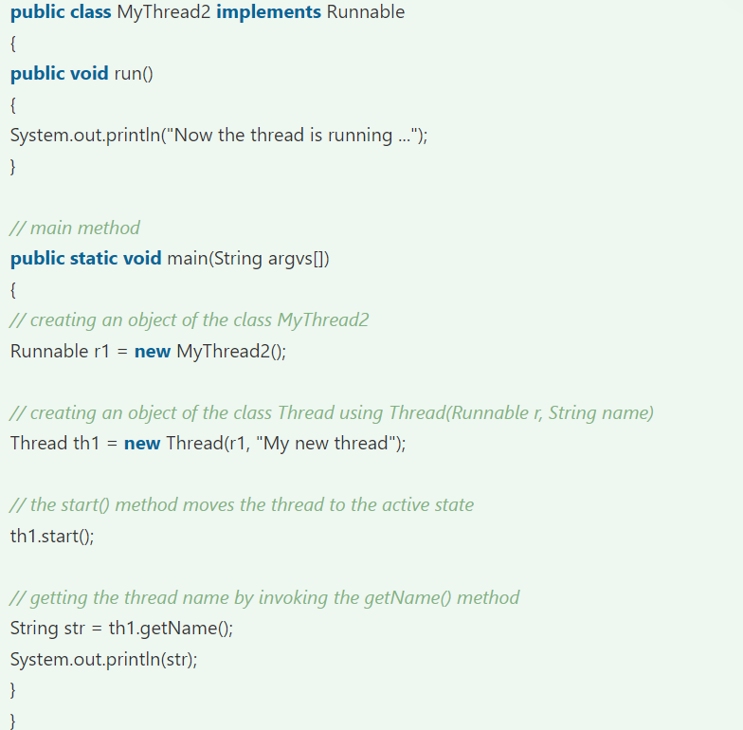
Using the Thread Class: Thread(Runnable r, String name)

Slide 15
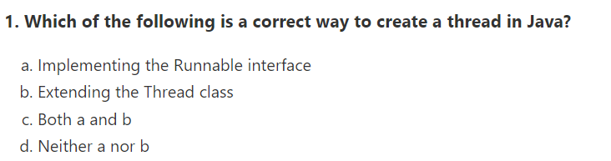
REVISION

Slide 16
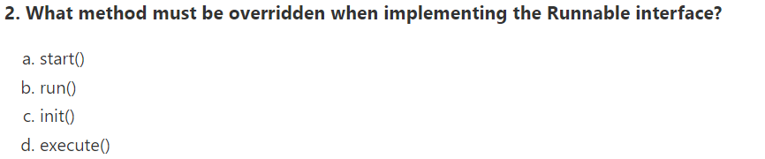
REVISION

Slide 17
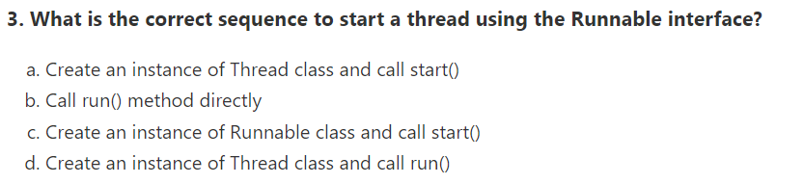
REVISION

Slide 18
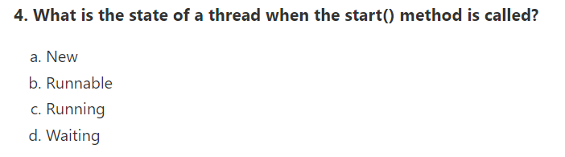
REVISION

Slide 19
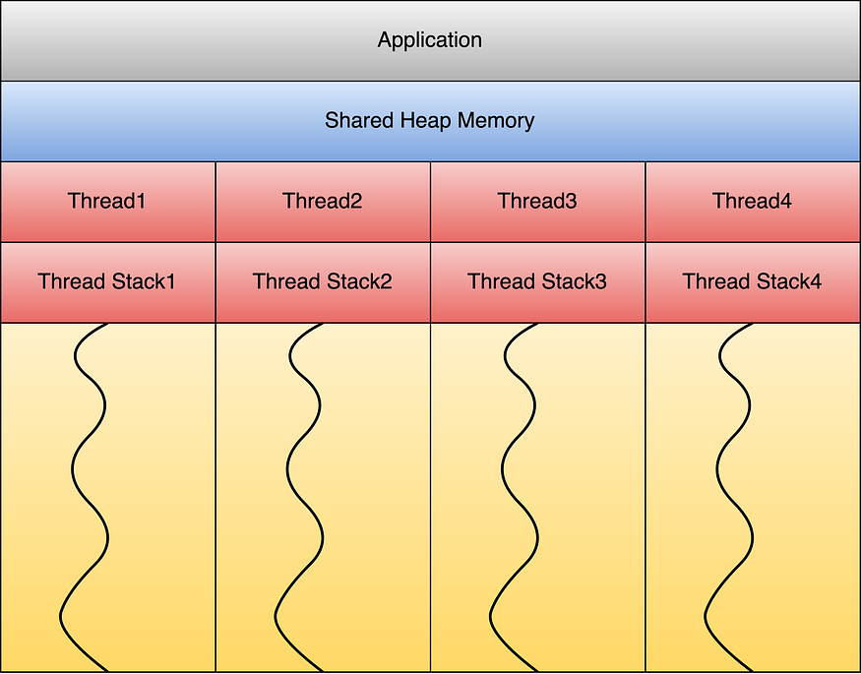
THANKS

